Slide 1

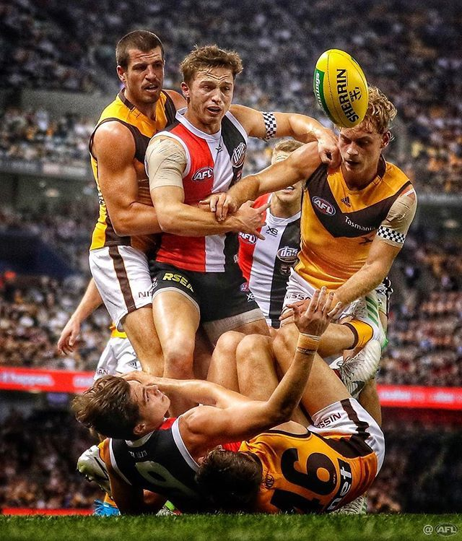
AFL Fantasy Football Analysis & Prediction
Photo credit: Michael Wilson (link)
Mark Richards

Slide 2
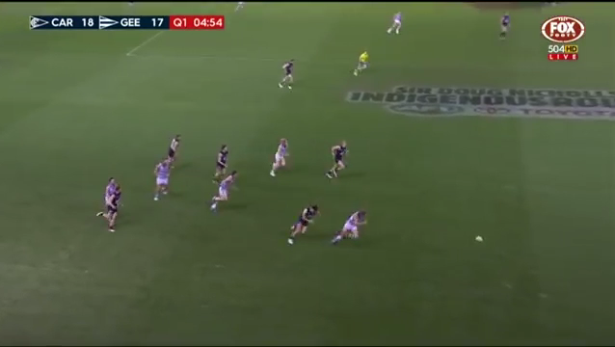
First off… What is Fantasy Football?
Players are awarded points for certain acts or stats during a match
1 kick ≈ 3 points
1 handball ≈ 1 point
1 goal ≈ 8 points

Slide 3
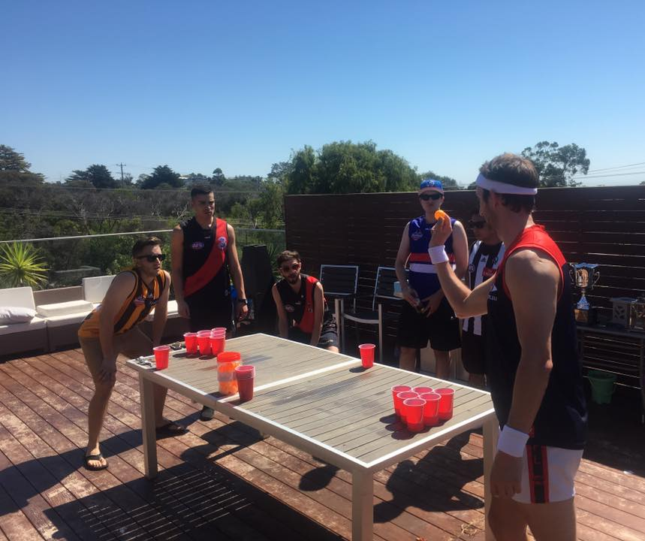
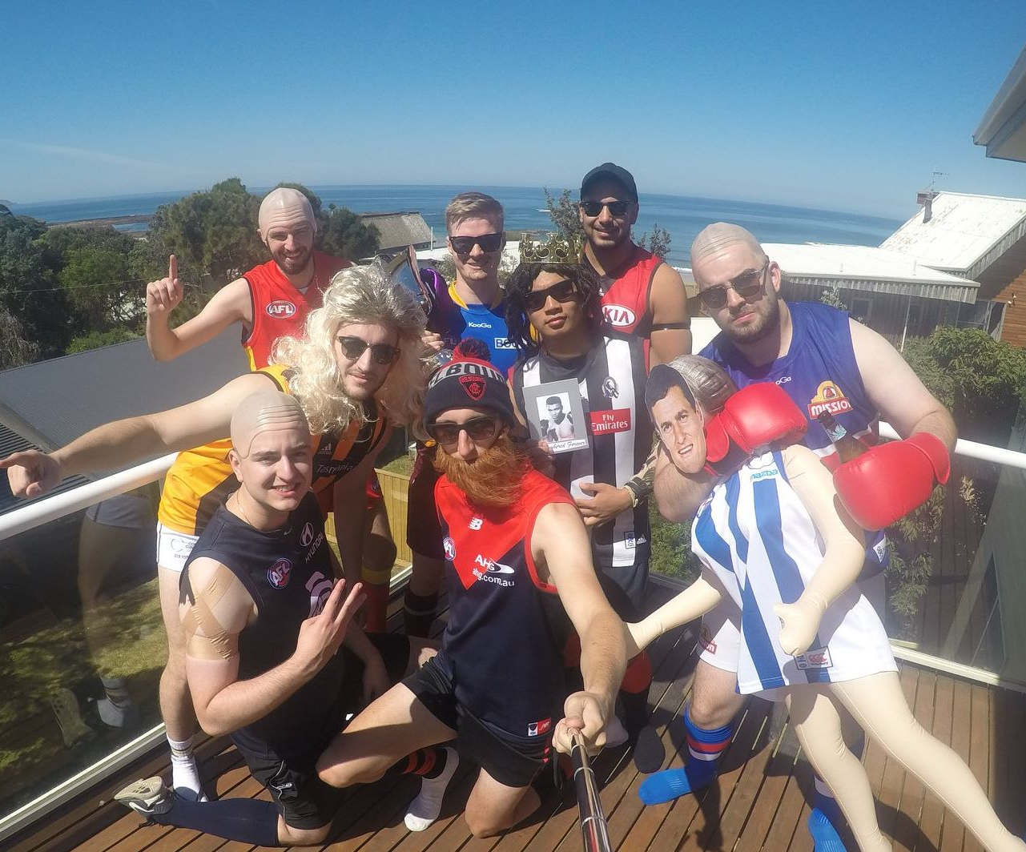

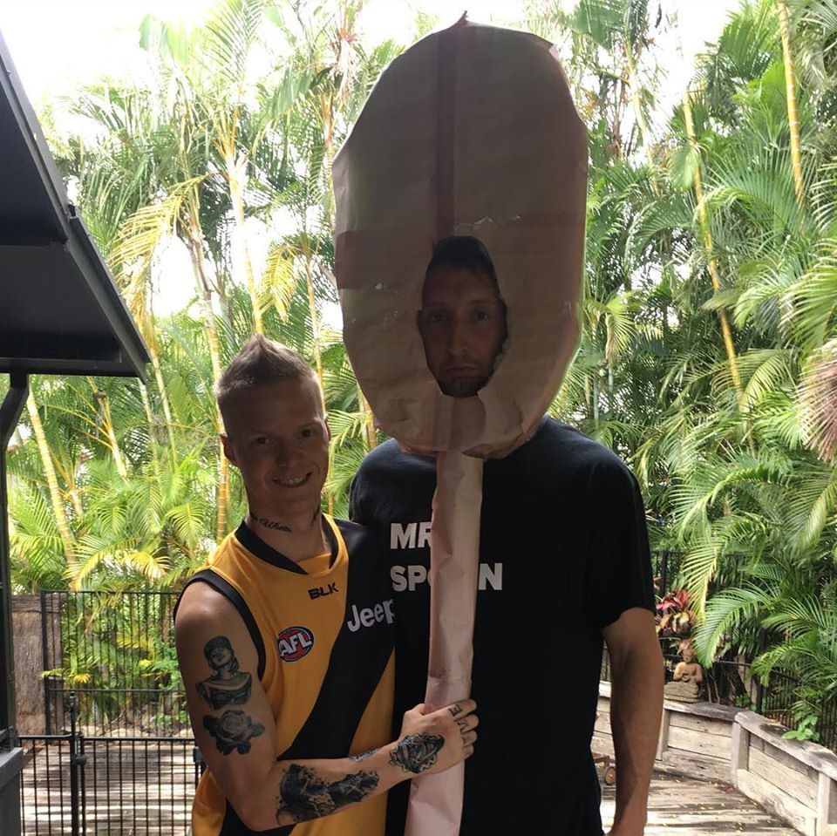
What is Fantasy Football?
YOU become the coach
Each week you are responsible for choosing a team of players
Highest points wins!
A.K.A Sport for nerds (Dungeons and Dragons for Jocks)
Yes that’s me as a wooden spoon after I finished last the previous year…

Slide 4
The Problem: What insights can be gathered from 10 years of AFL statistics and fantasy scores?
Goal 1
What is the best fantasy scoring method?
Goal 2
Predict future Fantasy scores for players

Slide 5


The Data: 2010-2019 AFL stats & results
Footywire.com.au
Approx. 90k rows
Merging was a challenge!
Fanfooty.com.au
Approx. 90k rows
Player Stats
Used fitzRoy package
Link
Match Stats
Player Stats + Notes
(used notes for injury identification)

Slide 6
Goal 1: What is the best fantasy scoring method?
How do you determine this?
Which is the strongest indication that a team will win?
Use fantasy scores to estimate the margin, closest to the margin wins!
Notebook Demo - link

Slide 7
Goal 2: Predict a player’s Supercoach score
Features used:
Rolling Supercoach score
Rolling stats (e.g. kicks, handballs, goals)
Opposition rolling Supercoach total score
Injured status
Notebook Demo - link

Slide 8
Learnings
Time spent…
30% collecting data
40% cleaning and matching data
Only 30% modelling/machine learning
The importance of explainability!

Slide 9
Next Steps
Build an API that will assist in week-to-week team selection
Simply plug in a player’s name + their opposition and the model will return their prediction for the coming week
Compare prediction with Supercoach’s own prediction
Potential to gather more information from player tags/notes

